Slide 1
LOOPING STATEMENTS IN JAVASCRIPT
Sai vardhan T

Slide 2
LOOPING STATEMENTS IN JS
WHILE
DO_WHILE
FOR
FOR_IN
FOR_OF

Slide 3
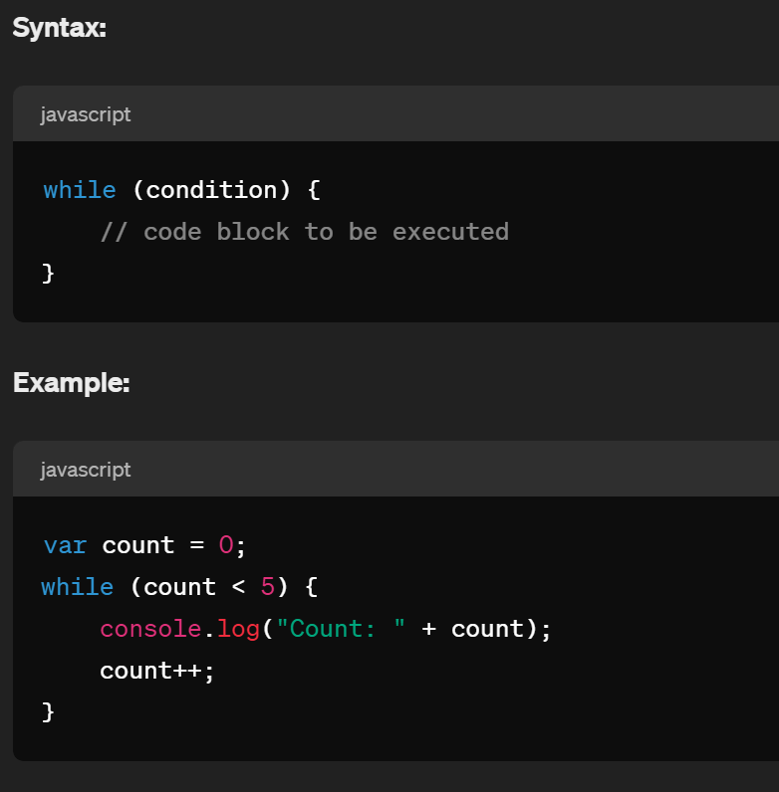
WHILE LOOP
The while loop executes a block of code as long as a specified condition is true.

Slide 4
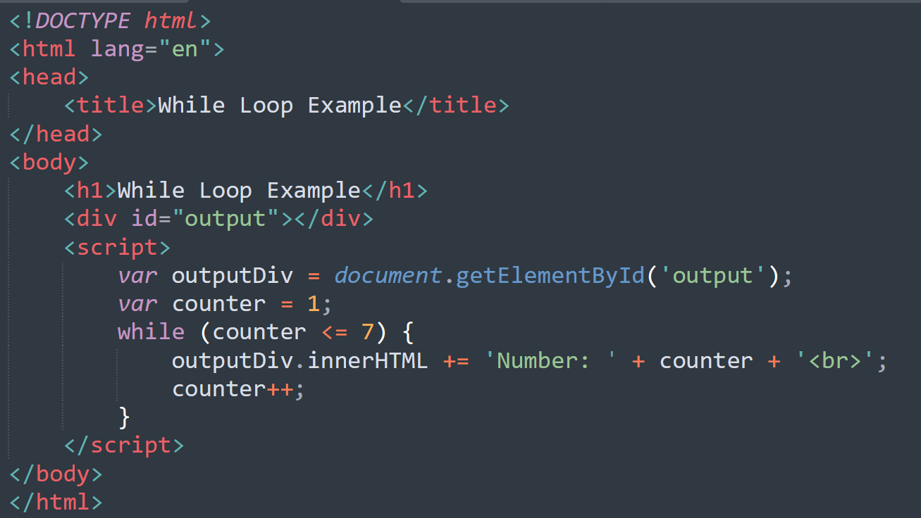
EXAMPLE

Slide 5
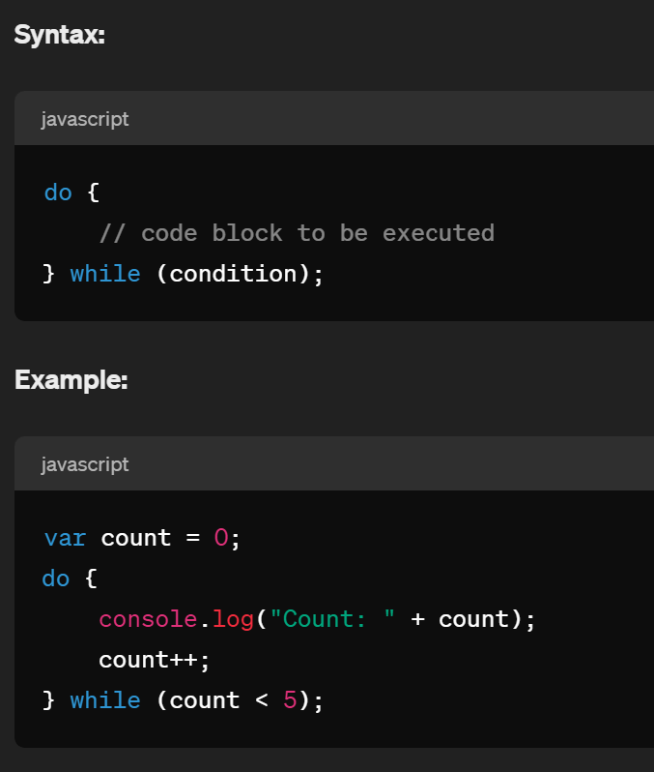
DO - WHILE
The do...while loop is similar to the while loop, but it always executes the block of code at least once before checking the condition.

Slide 6
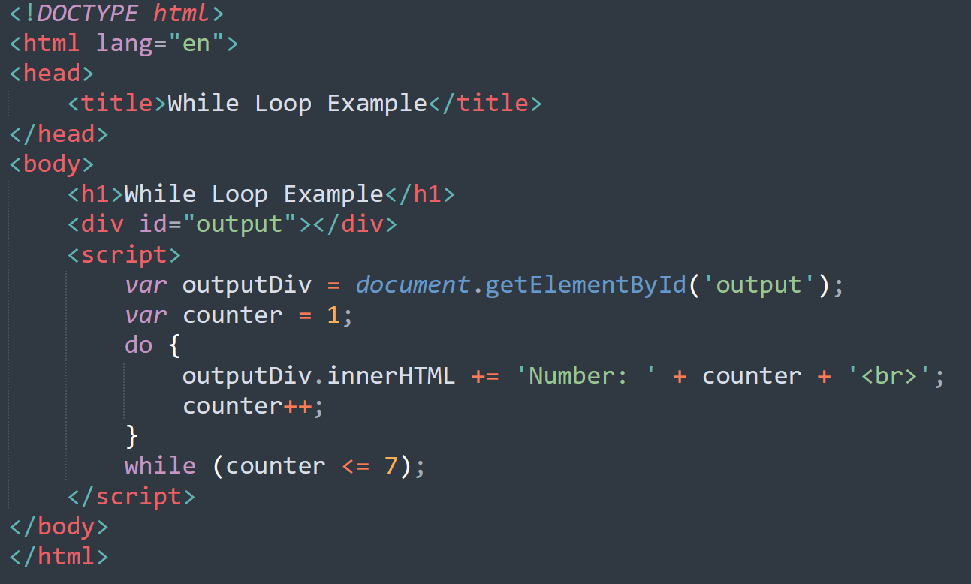
EXAMPLE

Slide 7
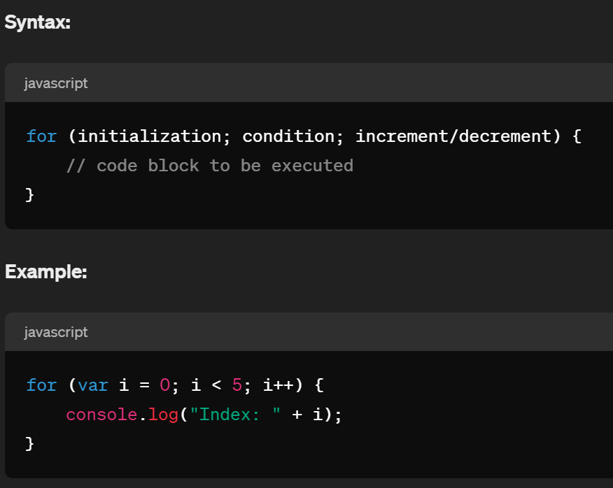
FOR LOOP
The for loop executes a block of code a specified number of times.

Slide 8
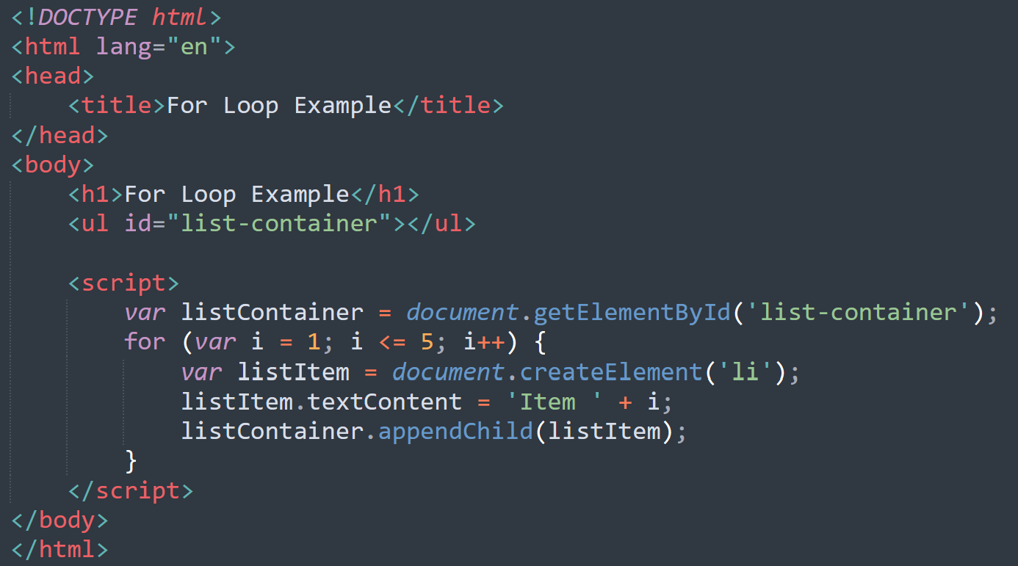
EXAMPLE

Slide 9
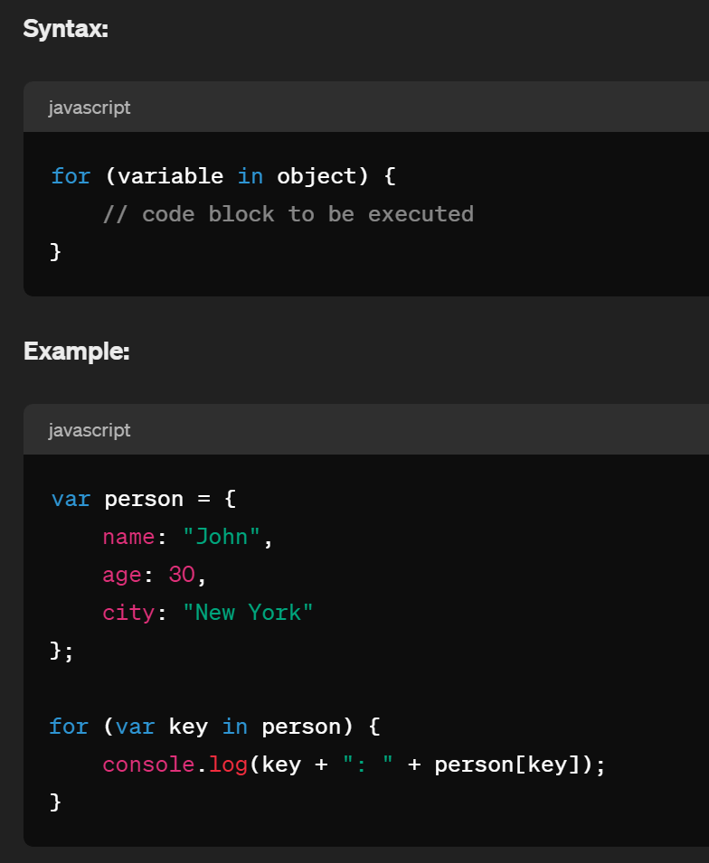
FOR IN LOOP
The for...in loop iterates over the properties of an object.

Slide 10
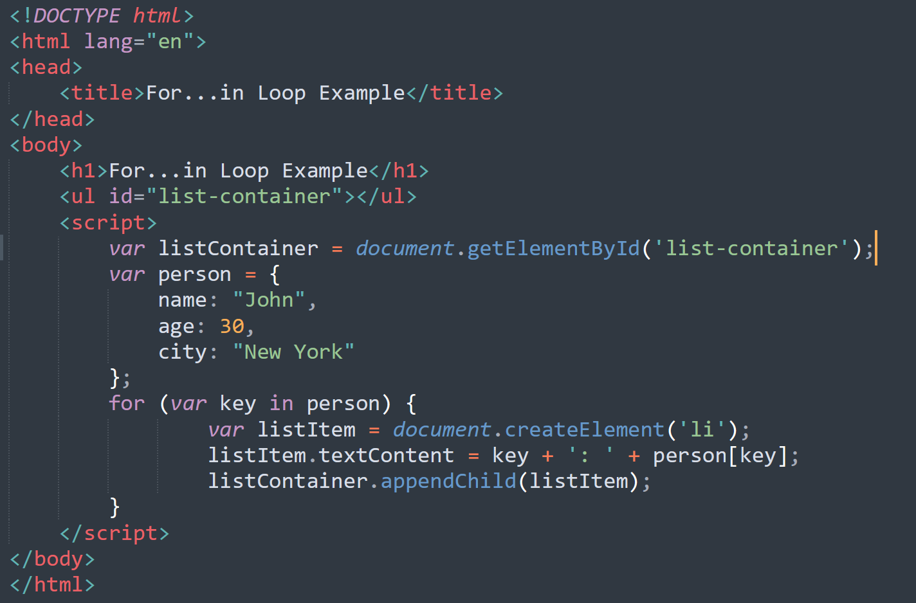
EXAMPLE

Slide 11
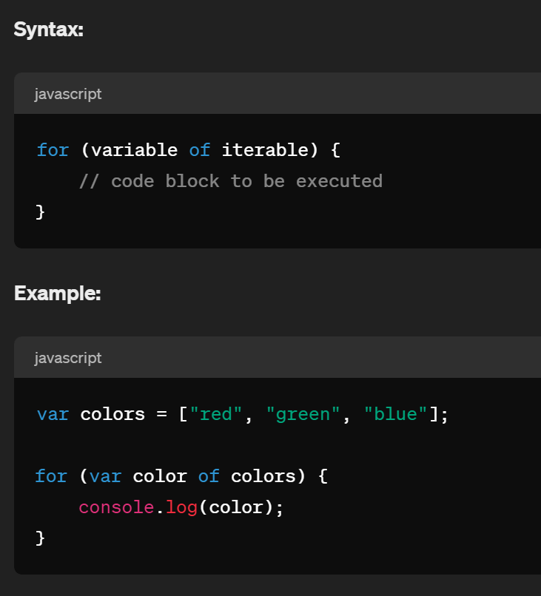
FOR OF LOOP
The for...of loop iterates over iterable objects such as arrays, strings, maps, sets, etc.

Slide 12
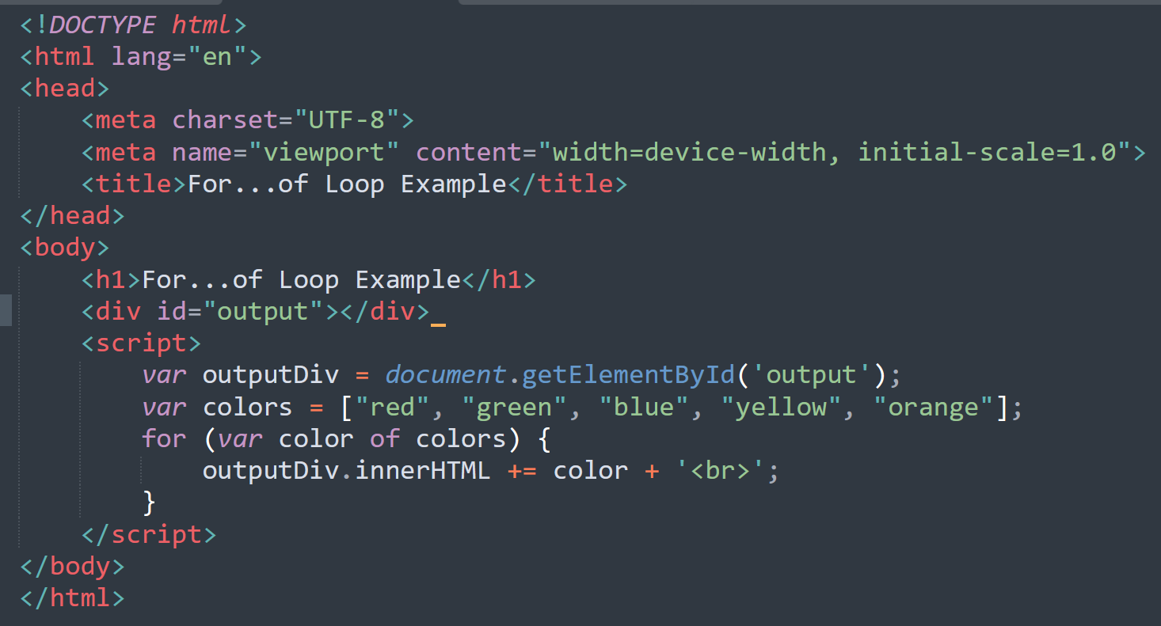
EXAMPLE

Slide 13
JUMP STATEMENTS
The jump statements are used to control the loop
If we want to control the loop once the loop is going on, then these jump statement comes into execution.
Type of Jump statements:
Break
Continue

Slide 14

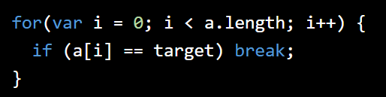
Break Statement
The break statement, used alone, causes the innermost enclosing loop or switch statement to exit immediately.
If the break statement is involved inside the loop, then the pointer will immediately come out of the Loop block
Its syntax is simple:
Example:

Slide 15

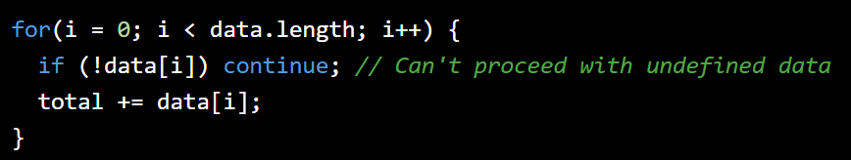
Continue Statement
The continue statement is similar to the break statement.
Instead of exiting a loop, however, continue to restart a loop at the next iteration.
Its Syntax is simple:
Example:

